Slide 1

f
Performance of Concrete Incorporating
Super Absorbing Polymers
Presented by:- Khushi Kumawat (2022UCE1610)
Gaurav Singh (2022UCE1243)
Nigam Kumar (2022UCE1425)
Mentor:- Dr. Sushree Sunayana

Slide 2
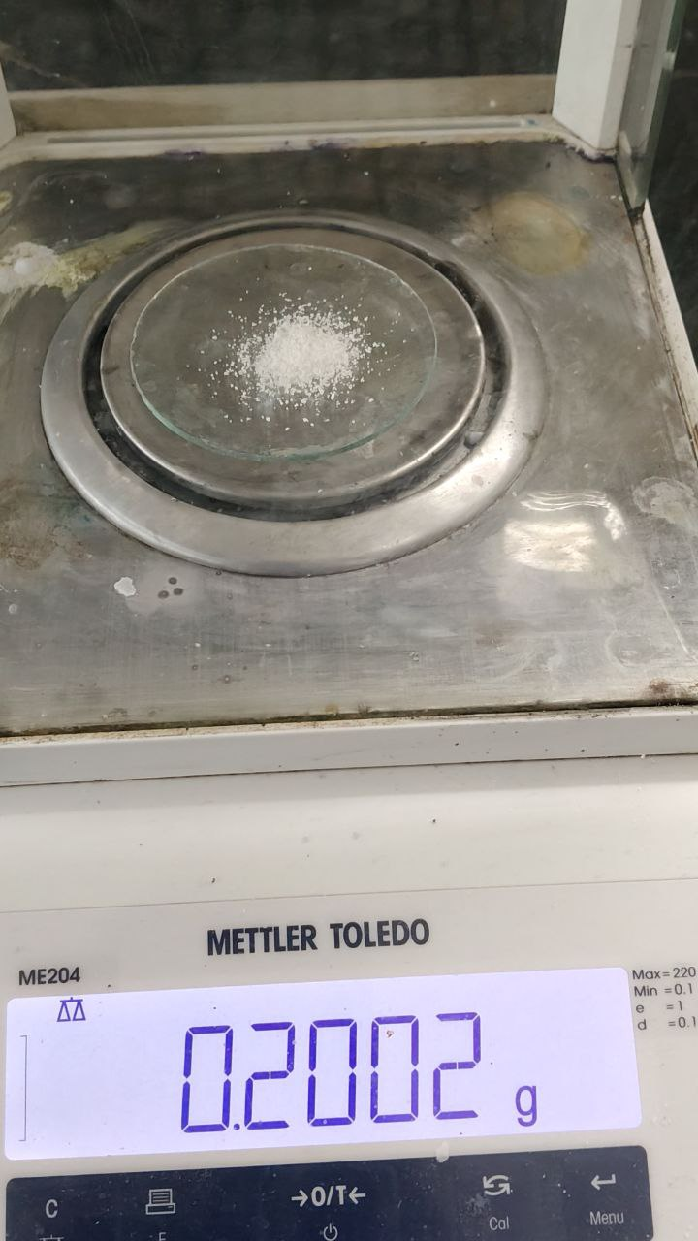
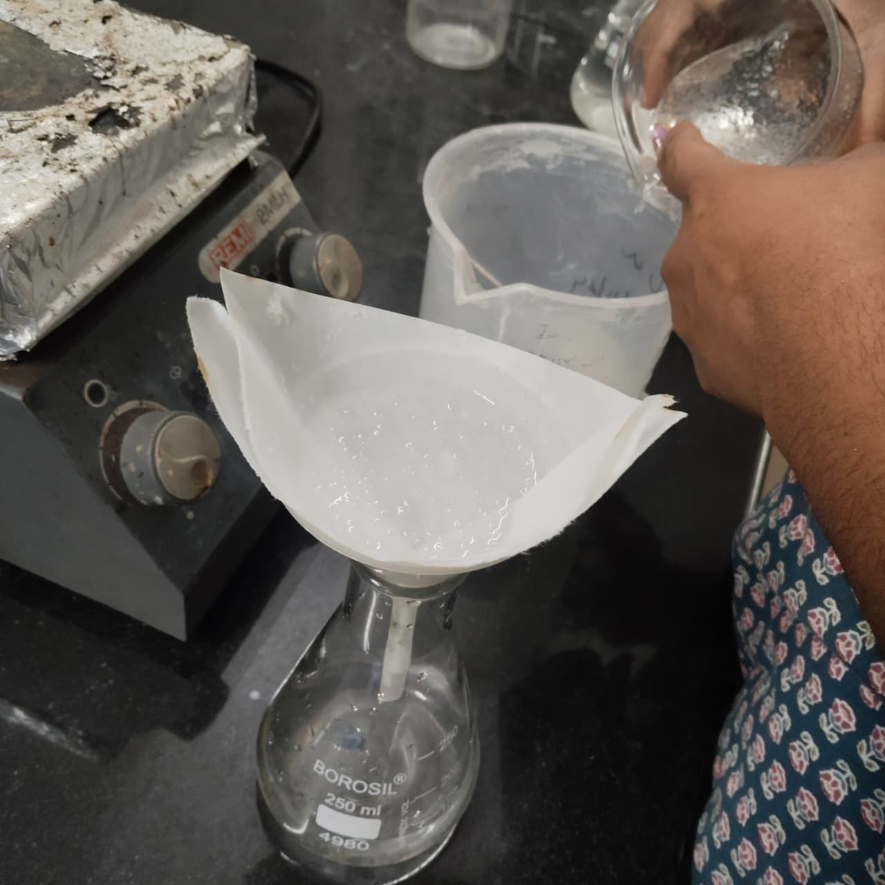
Introduction to SAP
SAP
Super Absorbent Polymer (SAP) are cross-linked polymers commonly composed of polyacrylate-based polymers capable of absorbing water several times their own weight.
When incorporated in concrete, SAP enables internal curing, especially beneficial for low w/c mixes.
Mechanism of SAP & Internal Curing
Swollen SAP
SAP absorbs water in its pre-wetted state during mixing and acts as an internal water reservoir.
As hydration progresses and internal relative humidity decreases, SAP gradually releases the stored water into the cement matrix.
This continuous water supply supports further hydration, reduces self-desiccation, and enables effective internal curing.

Slide 3
Need of the study
Low water-cement ratio concrete often lacks sufficient internal moisture for complete hydration.
External curing becomes challenging in semi-arid regions or in hot climate.
This results in self-desiccation, early-age cracking, and reduction in strength.
Optimal dosage of SAP for low w/c concrete is still not well-established, despite the capability of SAP to act as internal water reservoirs.

Slide 4
Objectives of the study
To investigate the absorption and desorption kinetics of Super-absorbing polymer in cementitious solution.
To investigate the effects of SAP on fresh and hardened concrete properties.
To determine the optimised dosage of SAP with a suitable low water-cement ratio.
To perform predictive analysis using statistical and machine learning models based on experimental data.

Slide 5
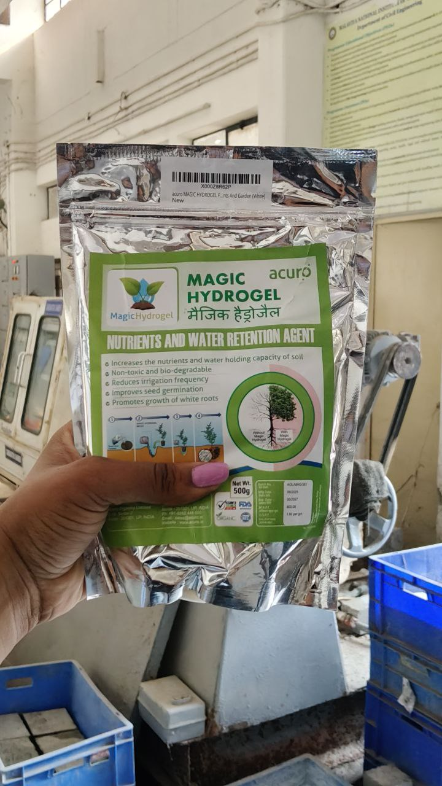

Study previous literatures and formulate objectives based on research gaps
Prepare concrete mixes with varying water-cement ratio with different SAP dosage
Experimental Testing
Fresh Concrete Property
Workability (Slump Test)
Hardened Concrete Property
Strength (Compressive Strength Test)
Data Analysis & Reporting
Data analysis and optimization
Literature Review
Mix Design
Preparation
Curing Comparison
Machine Learning and predictive modelling
Report writing and final presentation
Methodology
4

Slide 6

Literature Study
Sr. No. | Title | Author(s) | Year | Findings
1 | Superabsorbent Polymers for Internal Curing Concrete | Zhou, Wang, Taylor, Gu et al. | 2015 | Explains SAP chemistry and its role in internal curing; reduces self-desiccation, improves hydration, minimizes shrinkage, and enhances durability.
2 | Influence of Superabsorbent Polymers on the Surrounding Cement Paste | Wang, Yang, Hu, Li, Cheng et al. | 2016 | Shows SAP affects microstructure; increases early porosity but reduces it later; improves hydration (~5%) but may slightly reduce early strength.
3 | Application of SAP in Concrete Construction – RILEM Update | Mechtcherine, Wyrzykowski, Schrofl et al. | 2017 | Highlights shrinkage control, improved freeze–thaw resistance, and discusses challenges like SAP variability and dosage control.
4 | Measuring Absorption of SAP in Cementitious Environments | Zhao, Jensen, Hasholt | 2014 | Discusses testing methods like tea-bag method; absorption depends heavily on ionic concentration; emphasizes accurate measurement techniques.
5 | Absorption & Release Mechanism of SAP | Viktor Mechtcherine | 2010 | Explains swelling and desorption based on osmotic pressure and humidity gradients; polymer structure affects performance.
6 | Application of Super Absorbent Polymers (SAP) in Concrete | RILEM Technical Committee 225-SAP | 2013 | Provides guidelines on SAP use; covers rheology, shrinkage reduction, durability, and need for standardization.
7

Slide 7
Objective 1
“To investigate the absorption and desorption kinetics of Super-absorbing polymer in cementitious solution.”
SAP Characteristic Property Tests:
Absorption test
Desorption test
Tea-bag Absorption test
Open air-drying test

Slide 8
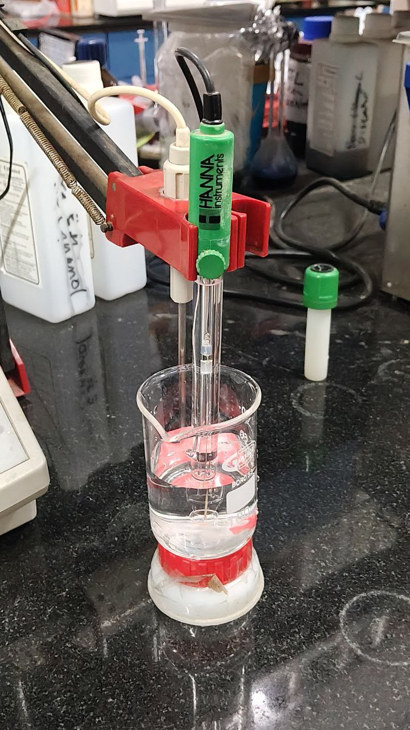
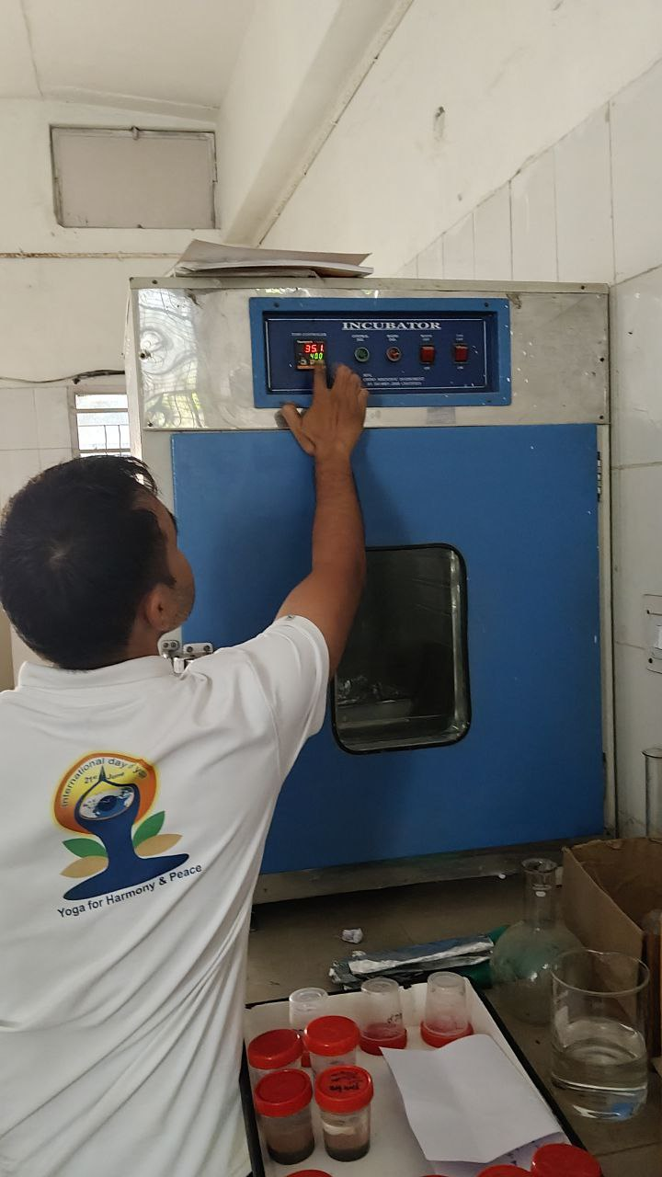
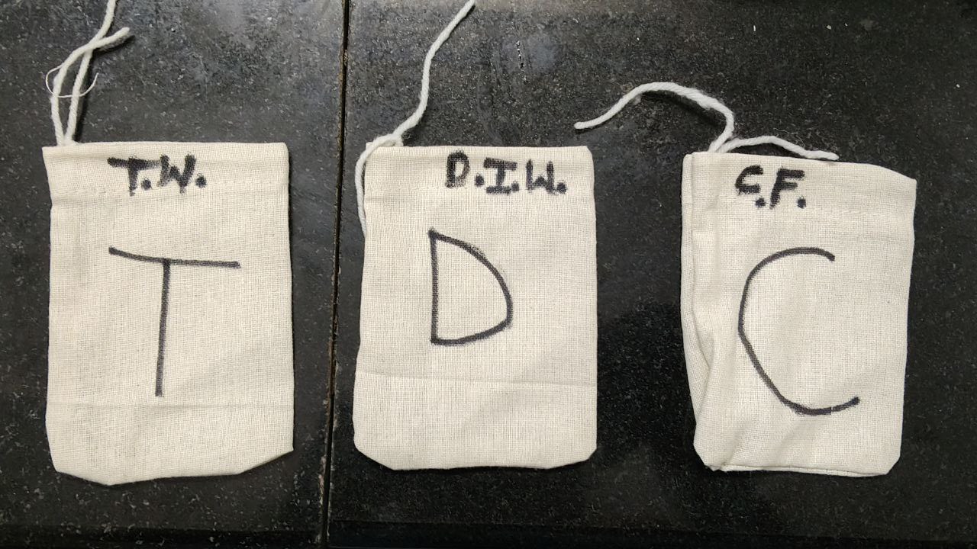
Tea-bag Absorption Test
pH value determination using probe:
Distilled Water (D.W) = 7.2
Tap Water (T.W) = 8.4
Cement Filtrate (C.F) = 13
pH measuring probe
1, 5, 10, 30, 60 min, 3 and 24 h after the SAP/liquid contact, the tea-bag with swollen SAP was taken out, gently wiped with a dry gauze, and weighed (mass mTB3)

Slide 9
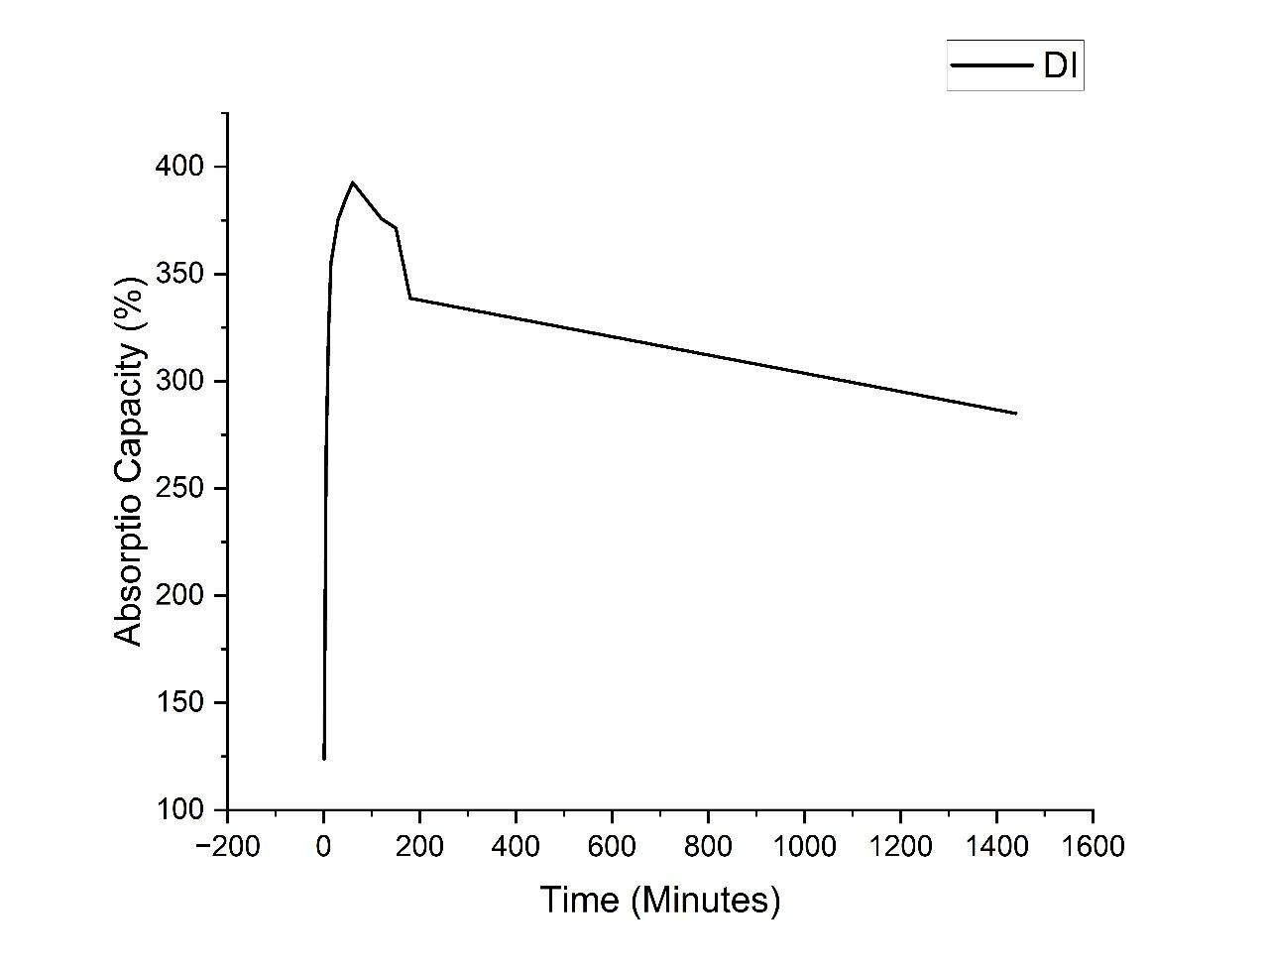
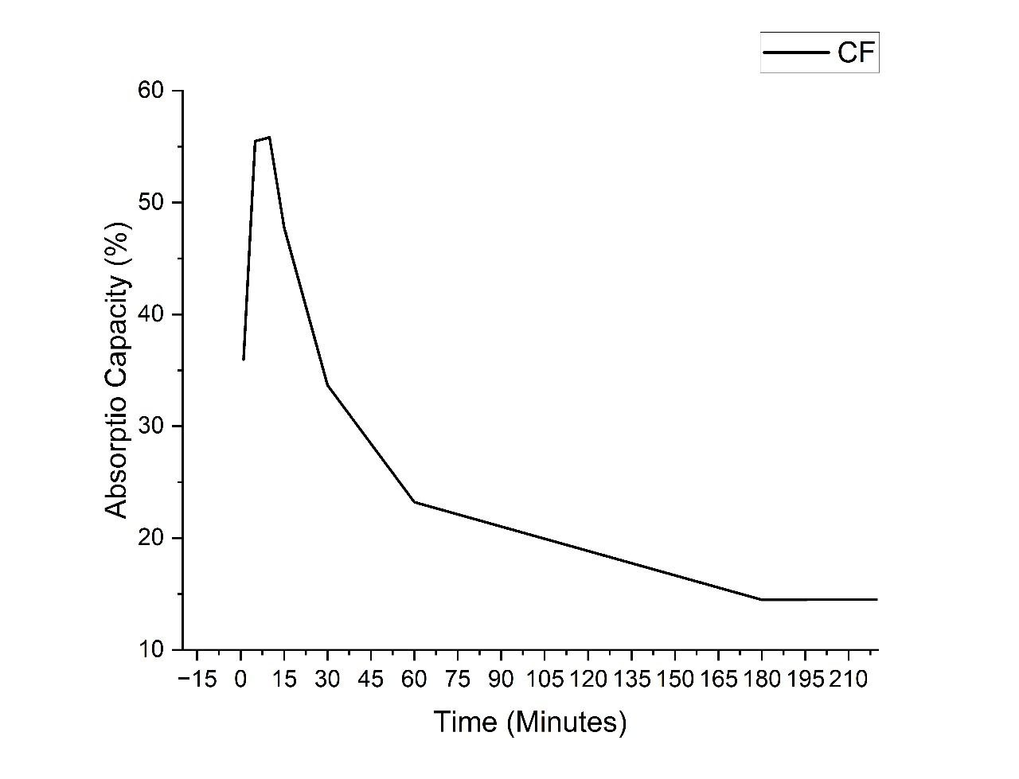
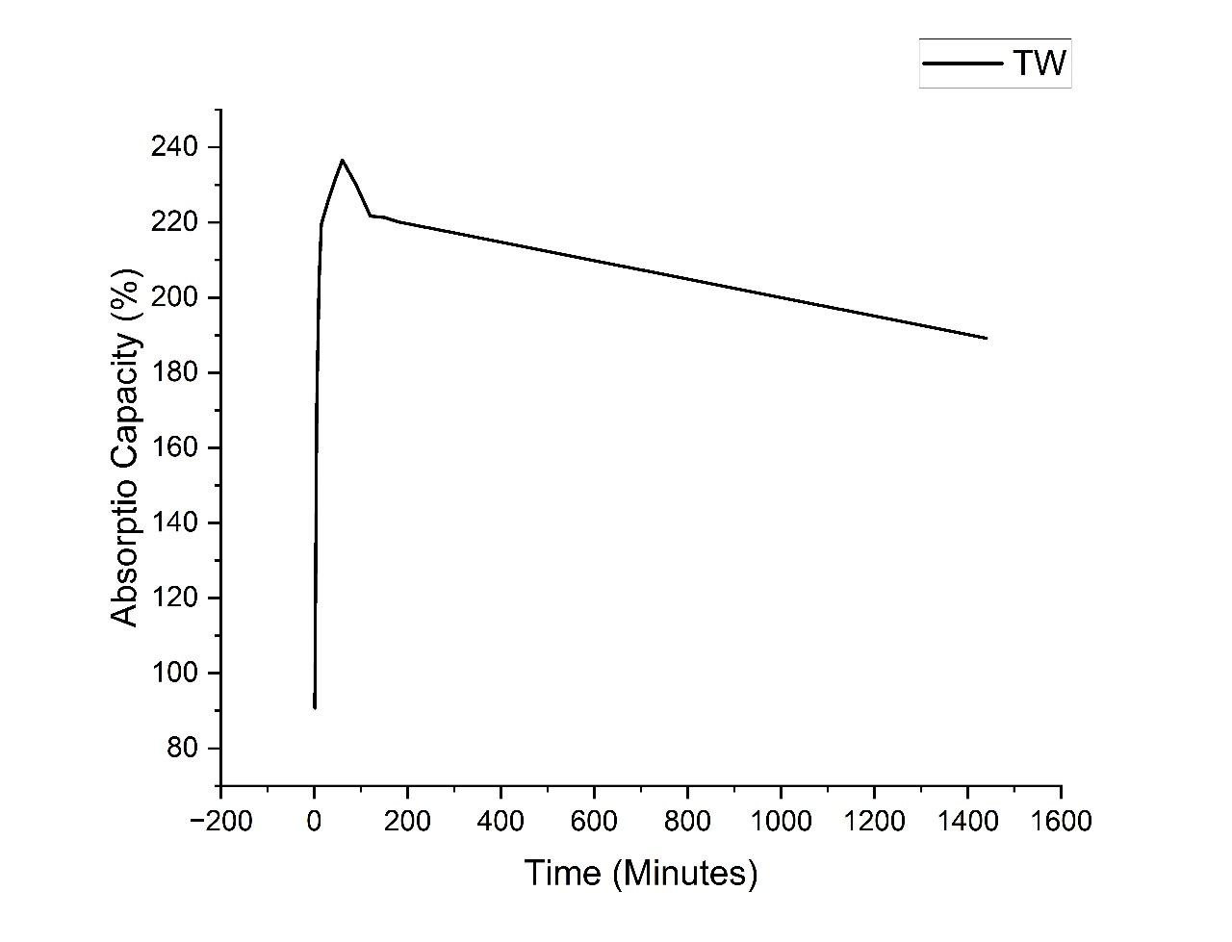



Tea-bag Absorption Test Results
Absorption Capacity Curves
(This results shows average of the three trials)
Distilled Water
Tap Water
Cement Filtrate

Slide 10
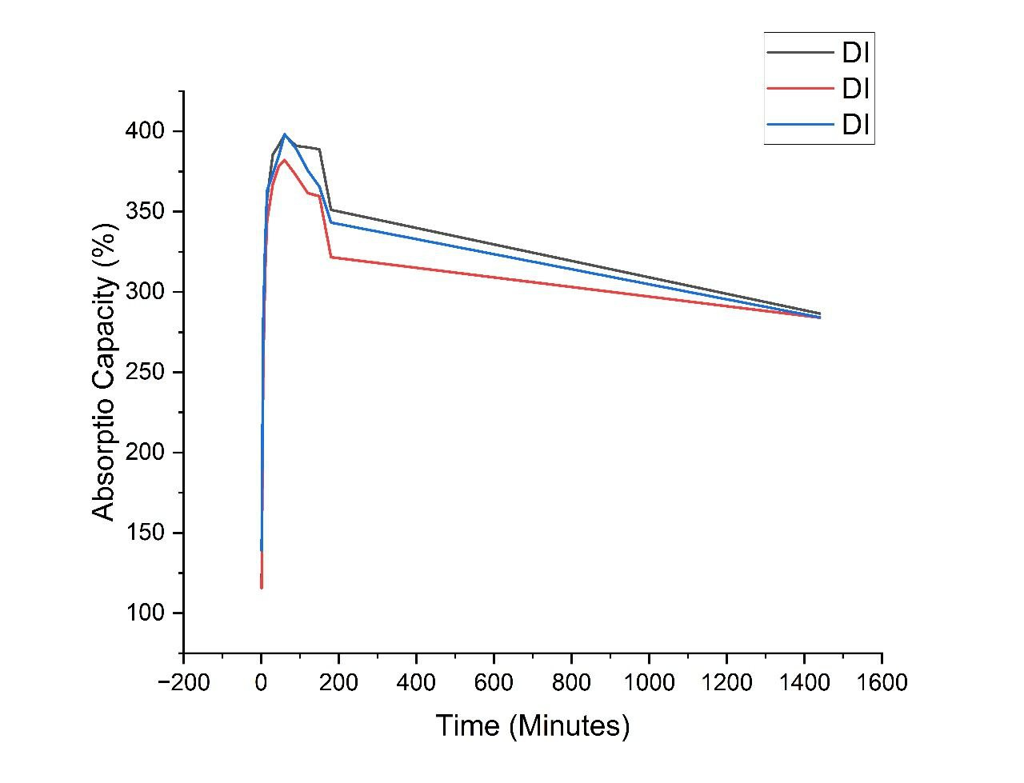
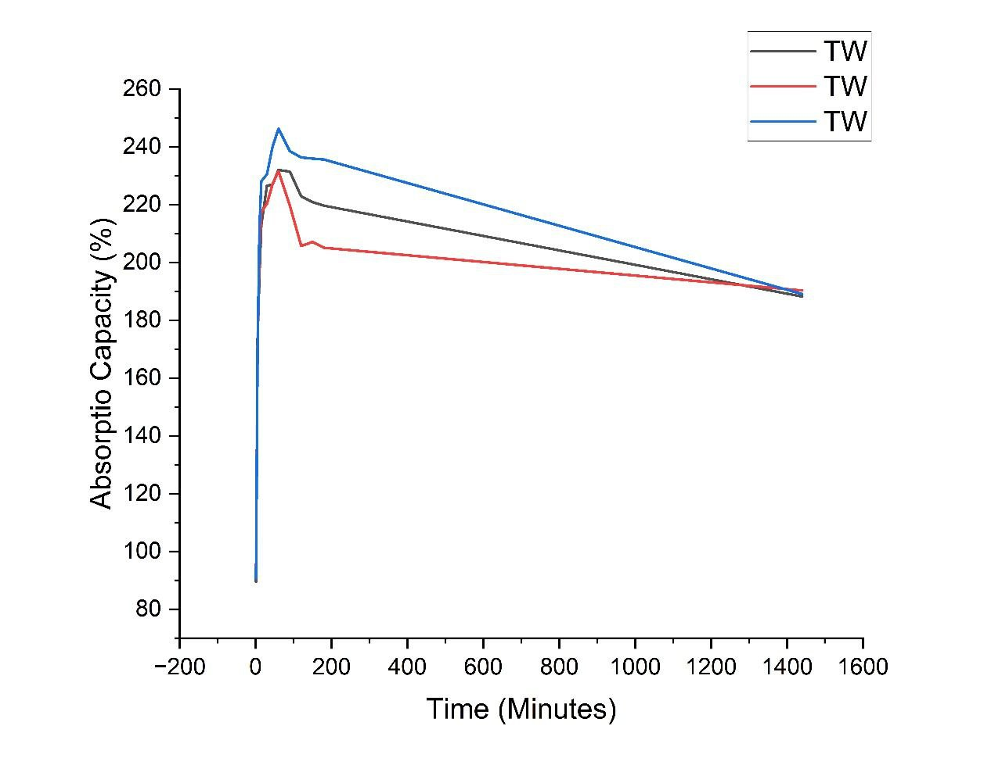
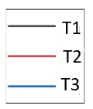
Tea-bag Absorption Test Results
Comparing values upto 24 hr:
Distilled Water
Tap Water

Slide 11
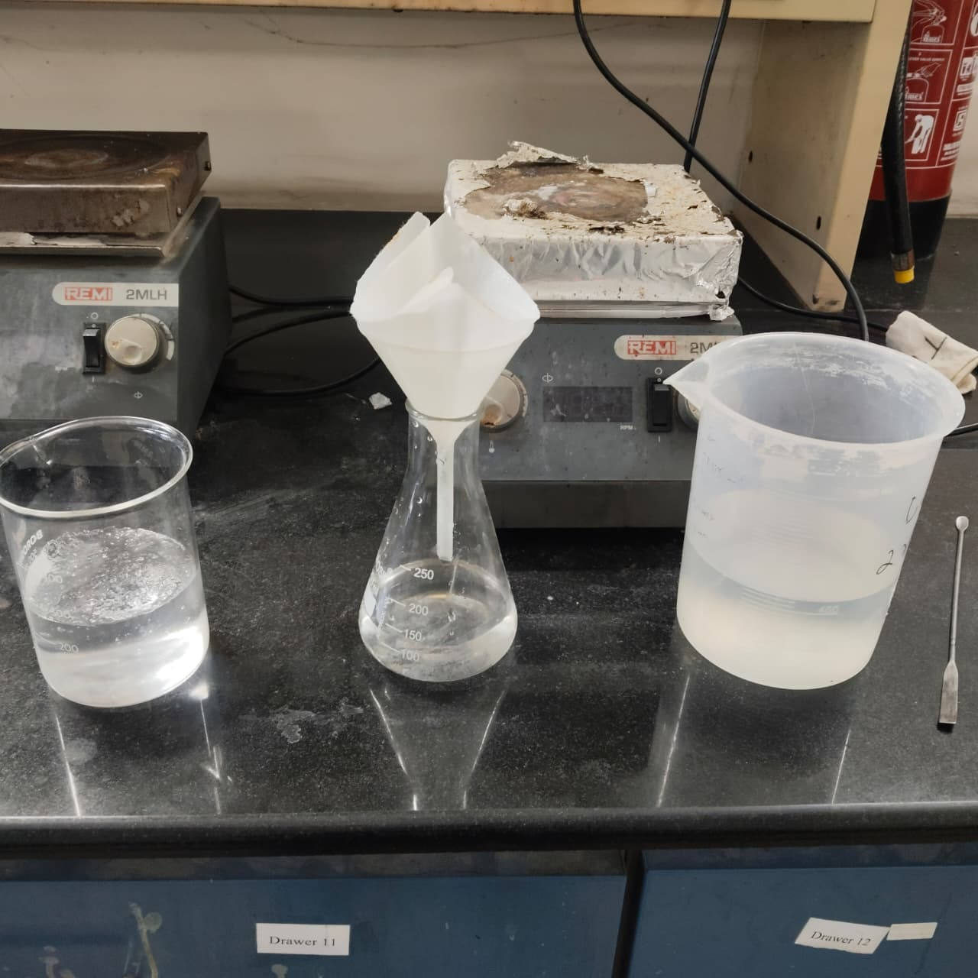
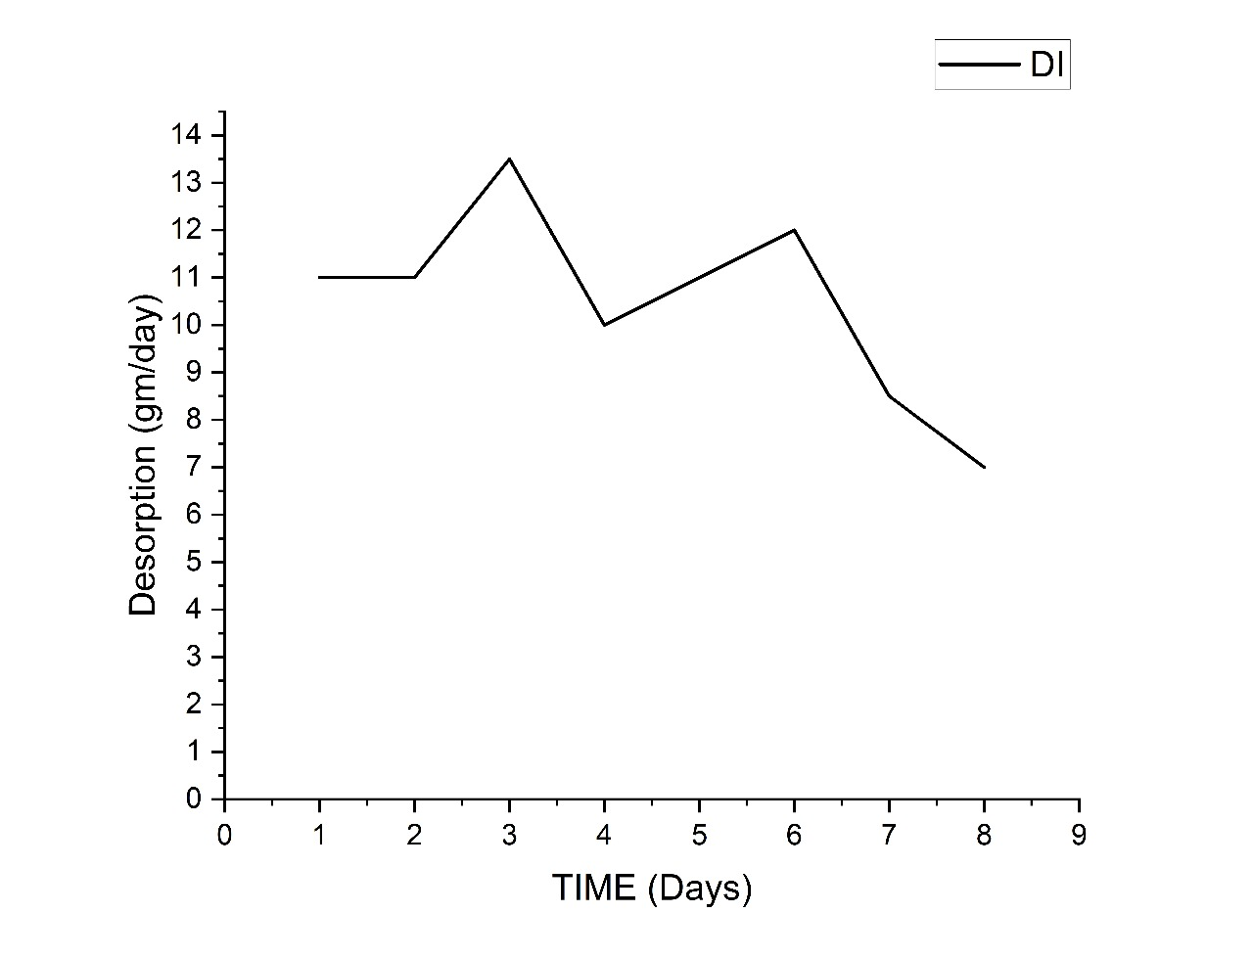
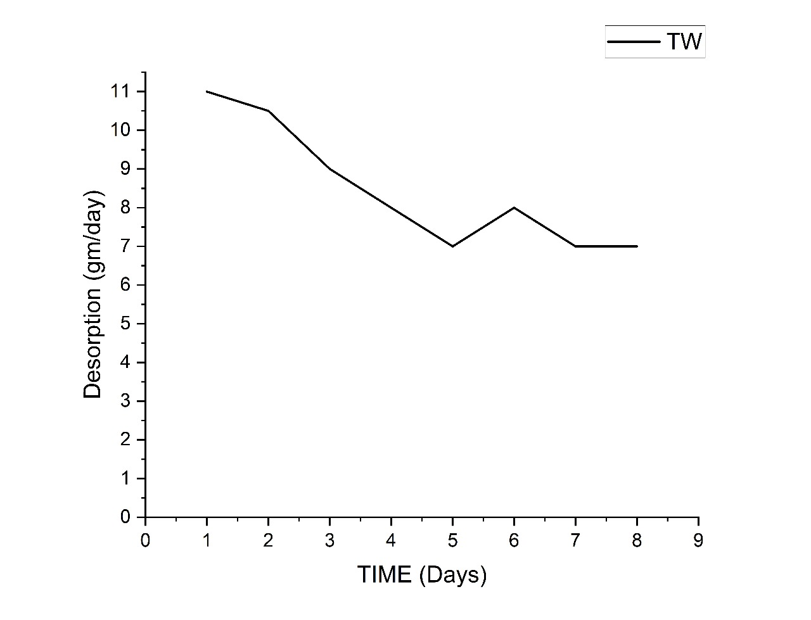

Desorption Test
Whatman filter paper
Open dry desorption in environmental conditions:
The Curve shows desorption rate of the SAP with number of days
Distilled Water
Tap Water

Slide 12
Inference:
SAP absorption-desorption behaviour:
Absorption:
SAP absorbs highly in distilled water (380–420%), moderately in tap water (230–260%), and very poorly in cement filtrate (<60%).
Therefore, SAP must be pre-wetted before adding to concrete.
Desorption:
SAP releases water slowly at 7–13 gm/day, providing continuous moisture for several days.
Distilled water SAP desorbs slightly more than tap-water SAP due to higher initial swelling.
Interpretation:
This behaviour supports the internal curing mechanism: SAP provides internal curing water once the external curing might be insufficient, ensuring better hydration and reducing self-desiccation.

Slide 13
Objective 2
“To investigate the effects of Super-absorbing polymer on fresh and hardened concrete properties.”

Slide 14
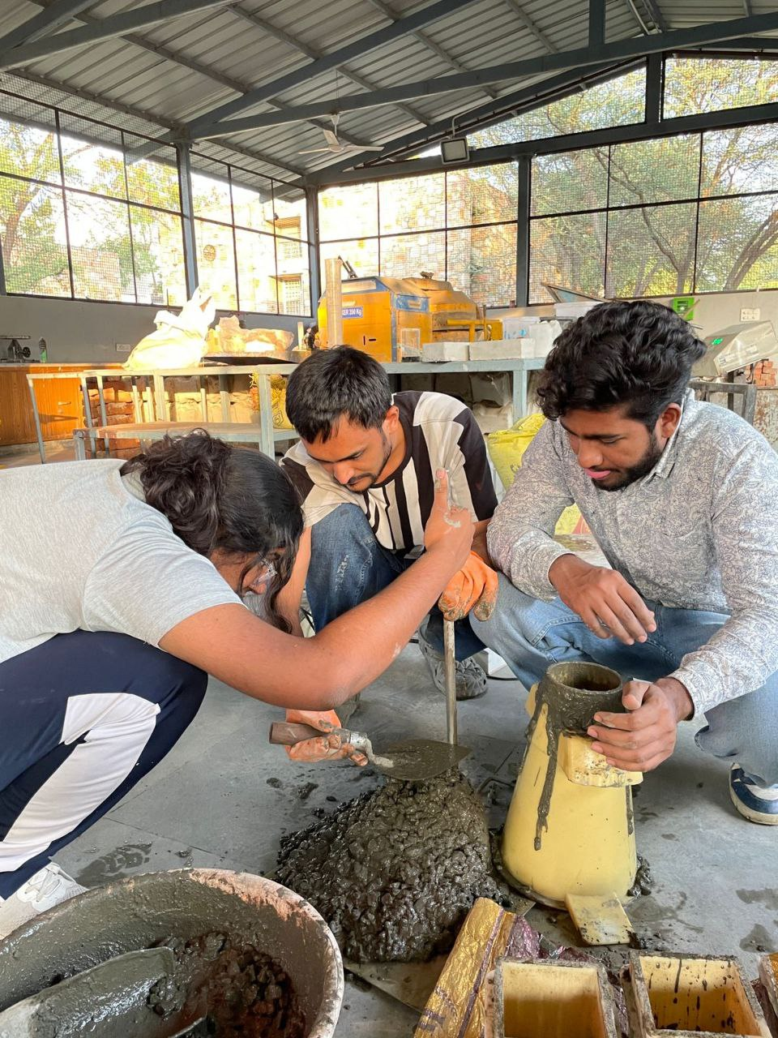
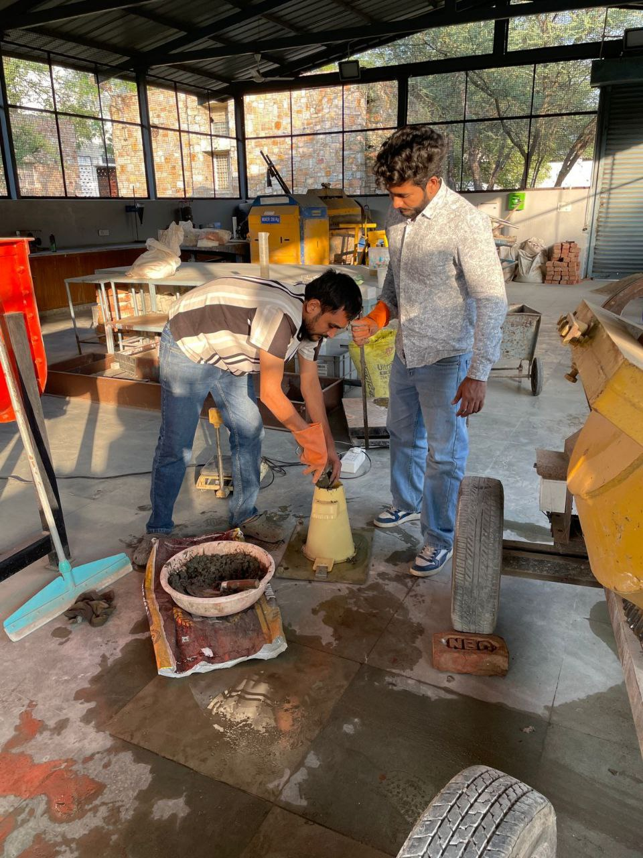
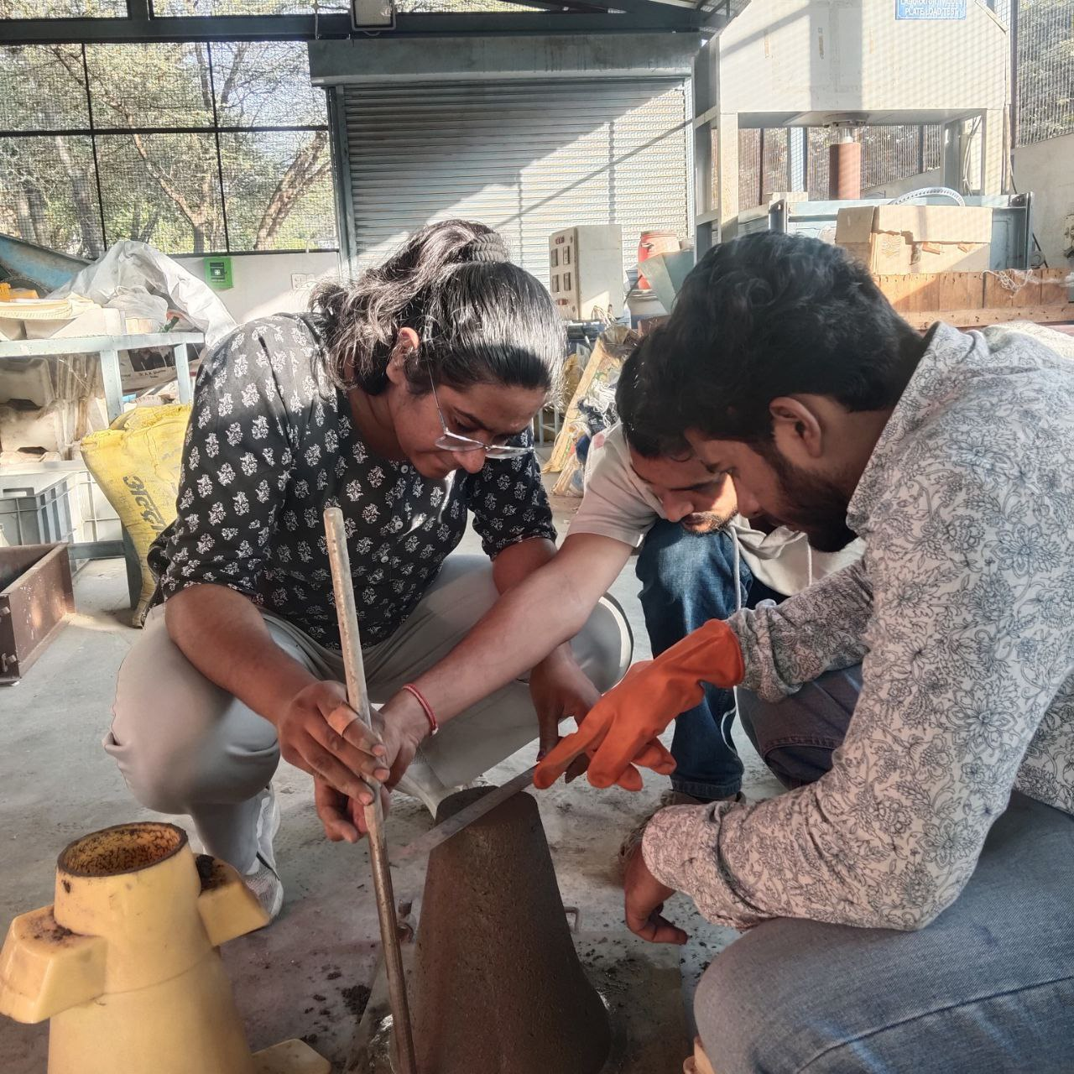
Fresh Concrete Test Slump Test-
Tamping and measuring rod
Slump cone

Slide 15
Fresh Concrete Test
Composition Number | Water Cement Ratio | SAP Dosage (% of cement by wt) | Slump Value (mm)
1 | 0.4 | 0.2 | 70
2 | 0.4 | 0.4 | 150
3 | 0.4 | 0.6 | 200
4 | 0.45 | 0.2 | 170
5 | 0.45 | 0.4 | 230
6 | 0.45 | 0.6 | 300
7 | 0.38 | 0.2 | 70
8 | 0.38 | 0.4 | 100
9 | 0.38 | 0.6 | 190
10 | 0.36 | 0.2 | 10
11 | 0.36 | 0.4 | 40
12 | 0.36 | 0.6 | 70
13 | 0.34 | 0.2 | -
14 | 0.34 | 0.4 | 30
15 | 0.34 | 0.6 | 60
Slump Test-
Inference:
Effect of SAP dosage variations- SAP dosage Slump
Effect of water-cement ratio variations- w/c Slump
When used in pre-wet condition and in suitable dosage, SAP provides the required workability which we lack in concrete with low water cement ratio.

Slide 16
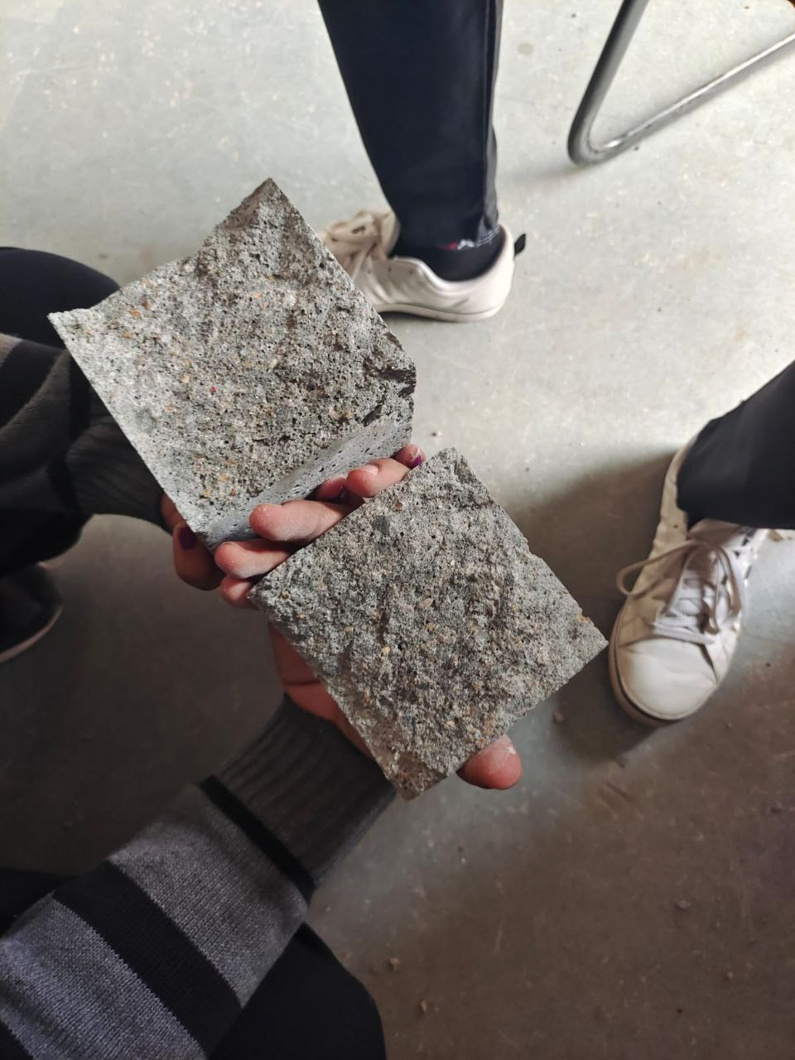
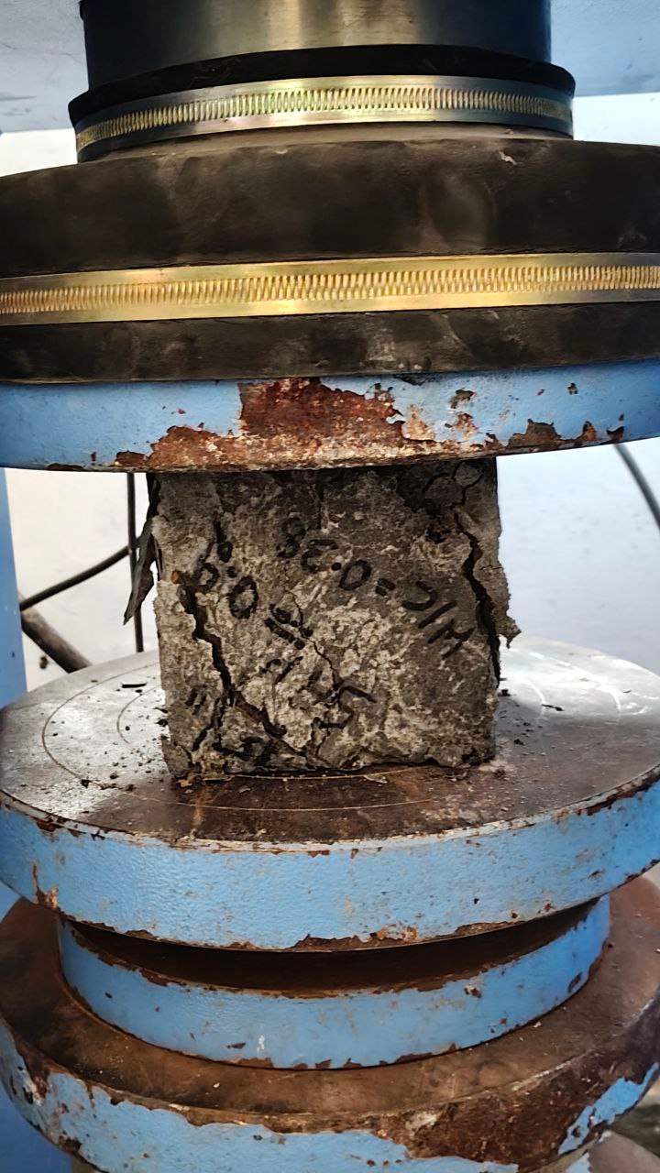
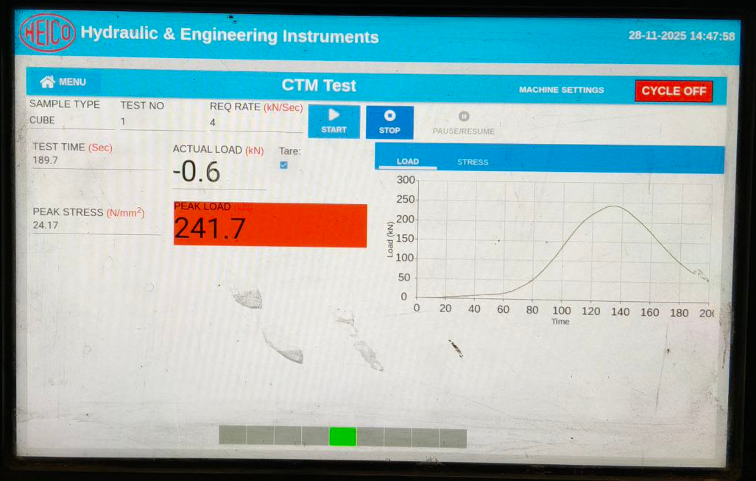
Hardened Concrete Test
Compressive Strength Test-

Slide 17
Objective 3
“To determine the optimised dosage of SAP with a suitable low water-cement ratio.”

Slide 18
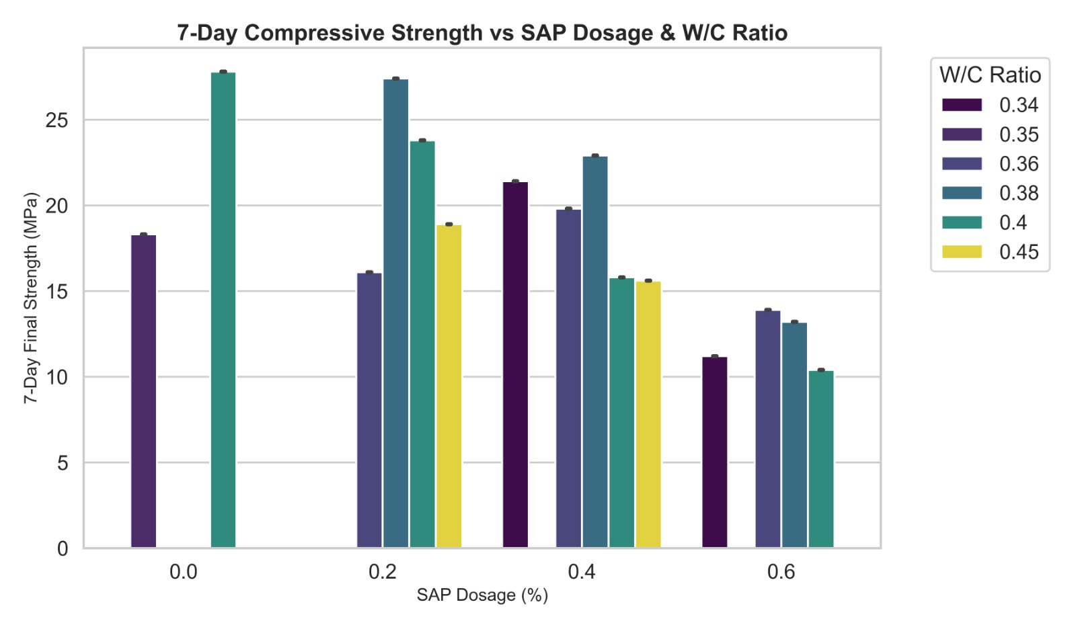
7-Day Compressive Strength Test:

Slide 19
7-Day Compressive Strength Test:
Inferences:
Best: w/c = 0.38 with 0.2 SAP
Excess SAP (0.6%) → reduces strength
Trend:
It will depend on the dosage and water–cement ratio; there is no general trend.
Optimum dosage lies between 0.2 and 0.4

Slide 20
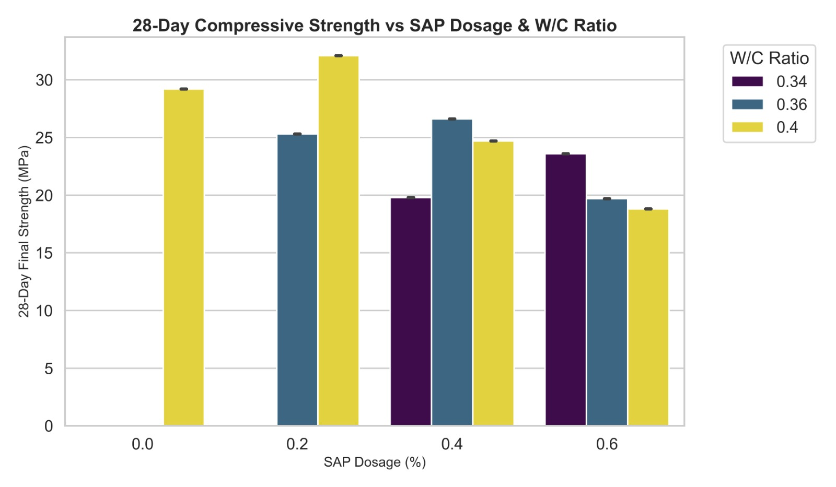
28-Day Compressive Strength Test:

Slide 21
28-Day Compressive Strength Test:
Inferences:
At w/c = 0.40 → 0.2% SAP gives highest strength
At w/c = 0.36 → 0.4% SAP performs best
At w/c = 0.34 → higher SAP improves strength due to internal curing
Trend:
SAP effect increases as w/c decreases, meaning that SAP’s effect is greater in low w/c ratio concrete.

Slide 22
Comparison of compressive strength with and without SAP
“To compare and analyse the strength of concrete with and without SAP.”
Readings:
Concrete Type | Avg. 7-Day Strength (MPa) | Avg. 28-Day Strength (MPa)
Without SAP | 27.8 | 29.2
With SAP (0.2%) | 23.8 | 32.1
Inference:
At 7 days → Without SAP > With SAP
At 28 days → SAP mix shows comparable / higher strength
Trend:
Early age → SAP ↓ strength
Later age → SAP ↑ hydration → ↑ strength

Slide 23
Comparison of conventional curing and internal curing
“To compare internal curing and conventional curing and investigate their effects on concrete performance.”
Readings:
Curing Mechanism | Avg. 7-Day Strength (MPa) | Avg. 28-Day Strength (MPa)
Conventional + Internal Curing | 19.8 | 26.6
Internal Curing (SAP) | 16.9 | 20.5
Inference:
At 7 days → Conventional + Internal > Internal only
At 28 days → Combined curing gives the highest strength
Trend:
More curing water → better hydration → higher strength

Slide 24
Objective 4
“To perform predictive analysis using statistical and machine learning models based on experimental data.”

Slide 25
Problem Statement:
Objective:
Develop an ML model to predict concrete strength
Analyze effect of:
SAP %
Water-Cement Ratio
Age
Build:
API (Flask)
Frontend (Streamlit)
Provide:
Real-time prediction
Visualization + Explainability
Concrete strength prediction is critical in construction
Traditional testing:
Time-consuming (7, 14, 28 days)
Costly and labour-intensive
Need for:
Faster prediction
Cost reduction
Optimisation of materials
Goal: Predict compressive strength using ML instead of physical testing

Slide 26
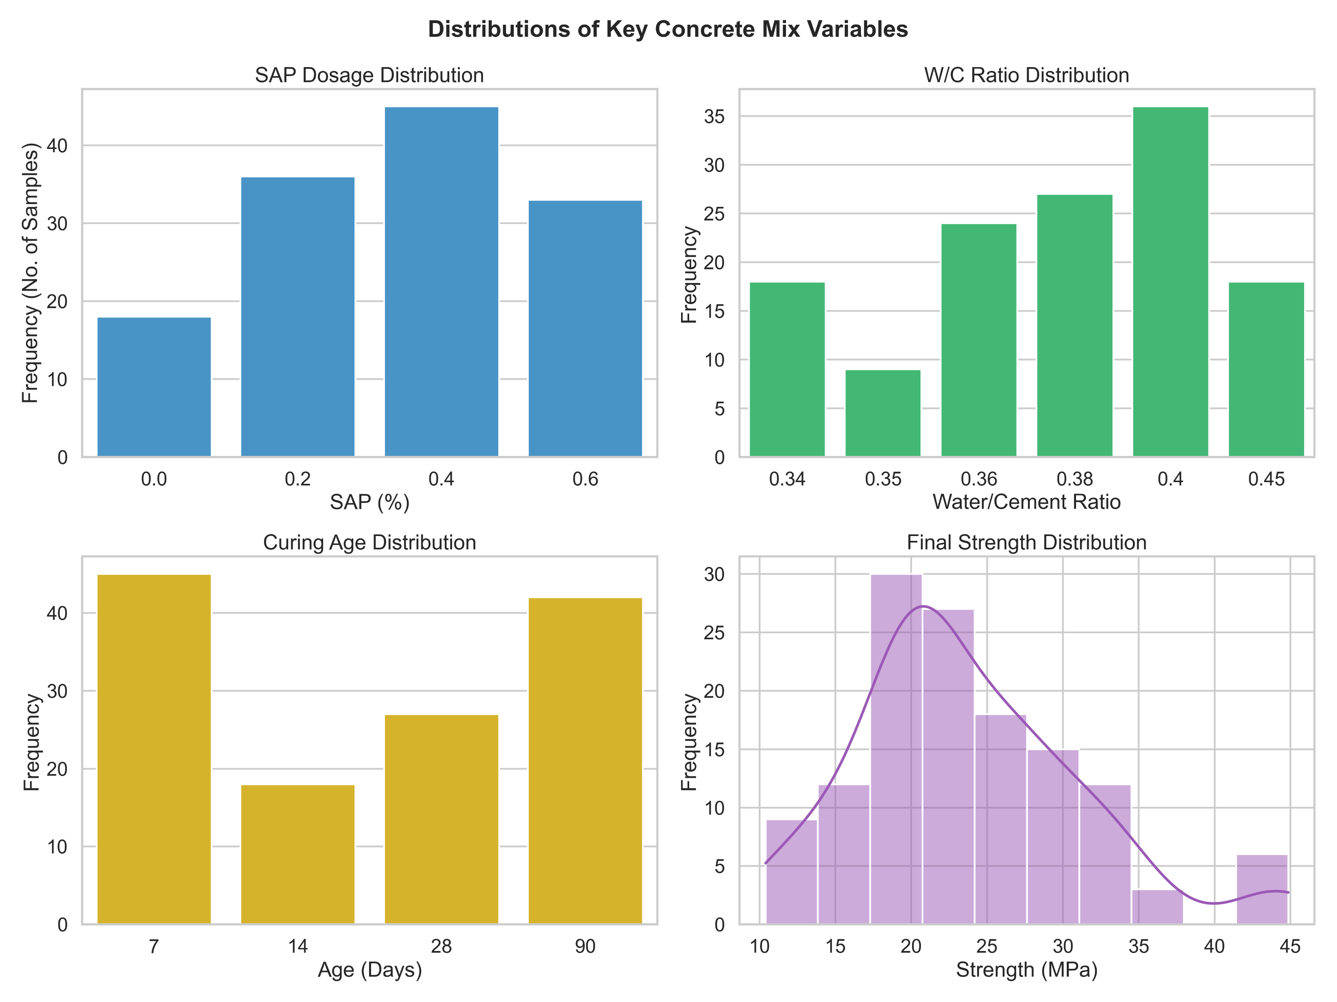
Dataset Description:

Slide 27
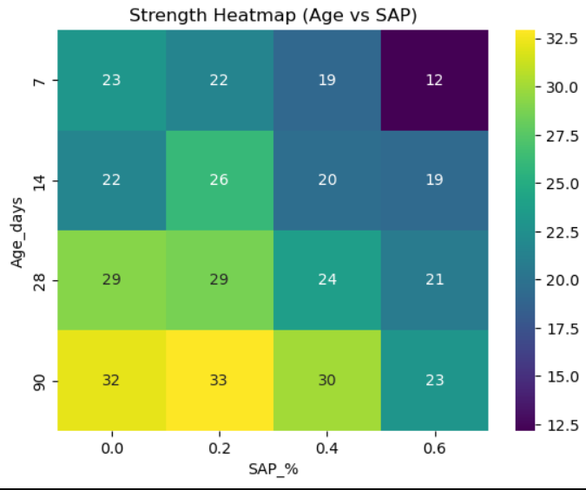
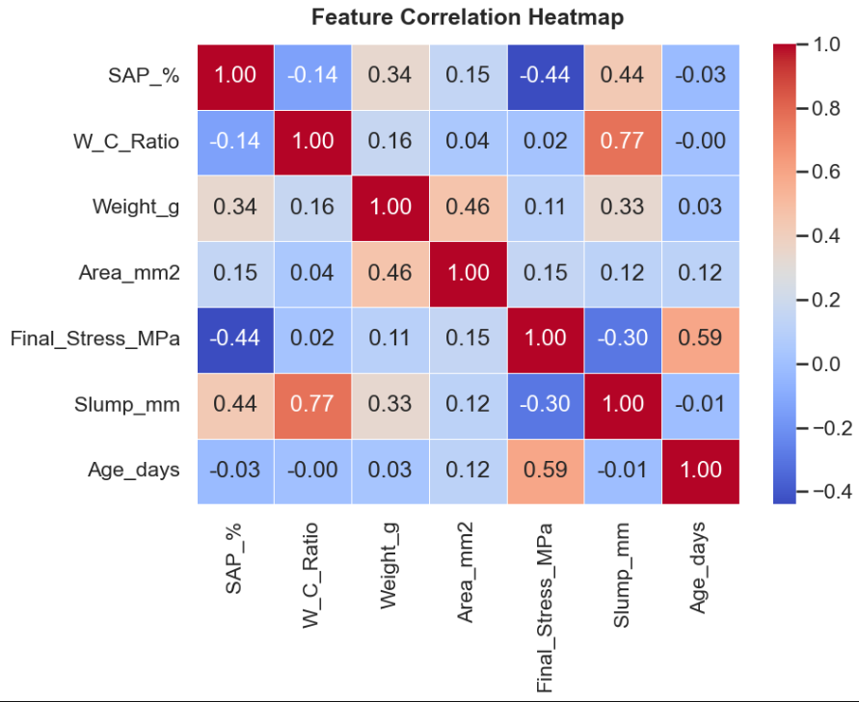
Exploratory Data Analysis (EDA):

Slide 28
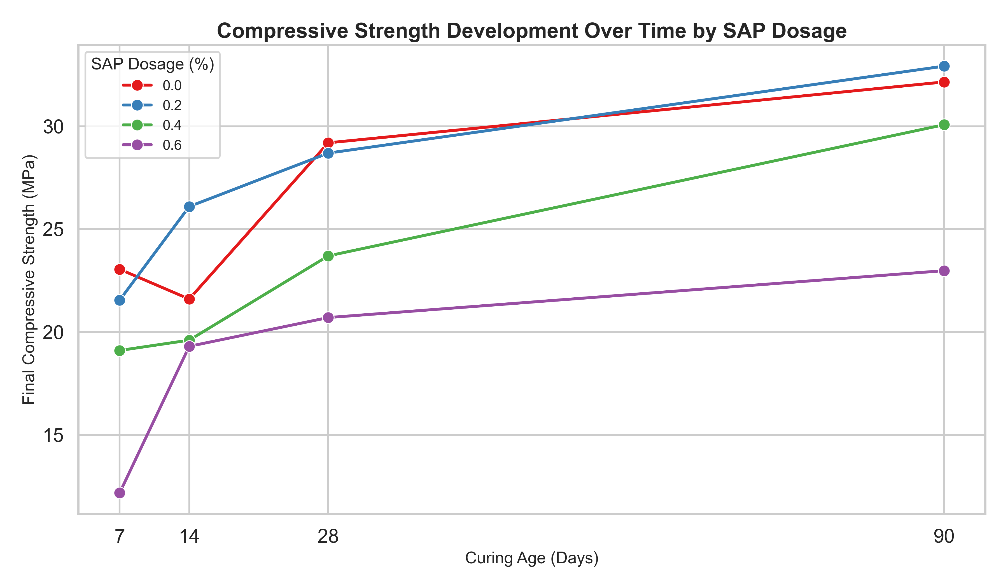
Exploratory Data Analysis (EDA):

Slide 29
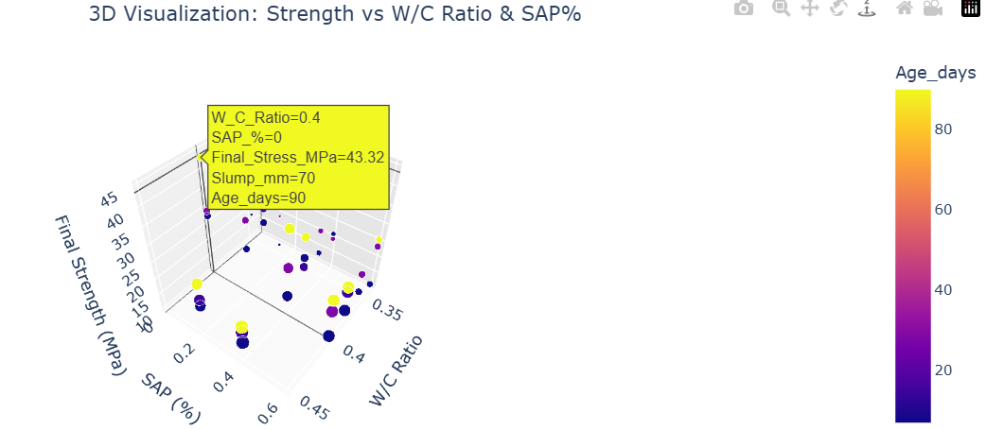
Exploratory Data Analysis (EDA):

Slide 30
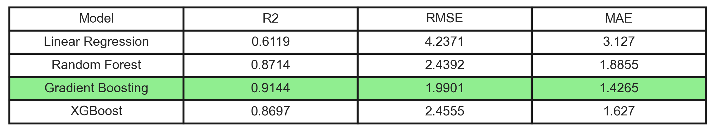
Model Selection:
Algorithm Used:
Gradient Boosting Regressor(Final Model)
Why XGBoost?
Achieved the highest R² score (0.9144) indicating better prediction performance
Produced the lowest RMSE (1.9901) showing minimum prediction error
Obtained the lowest MAE (1.4265) ensuring more accurate predictions
Handles non-linear relationships effectively
Uses boosting (sequential learning) to improve model performance step-by-step
Provides better generalization compared to other evaluated models

Slide 31


Slide 32
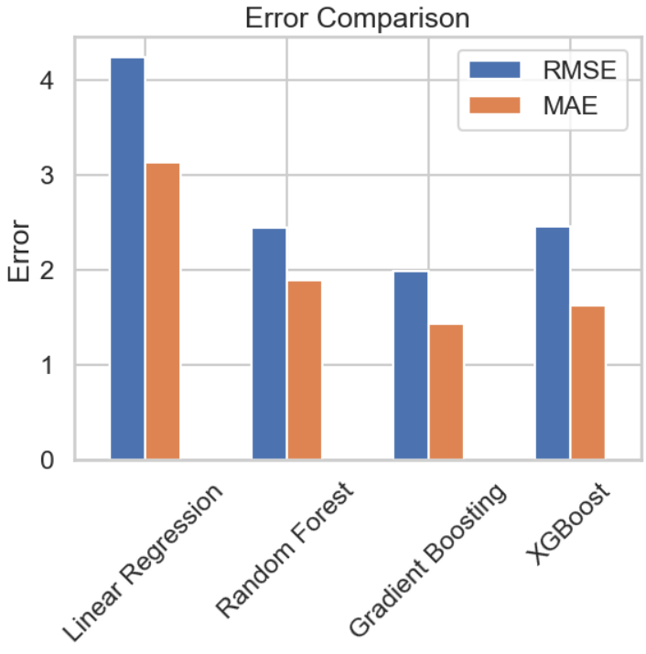
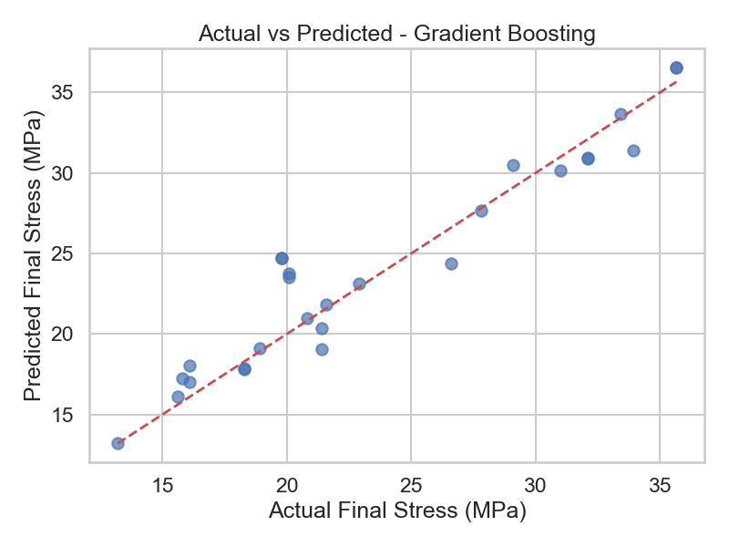
Model Validation:
Error Analysis:
Points are close to diagonal line
Indicates good prediction accuracy
Gradient Boosting has:
Lowest error among all models
Confirms it as best performing model

Slide 33
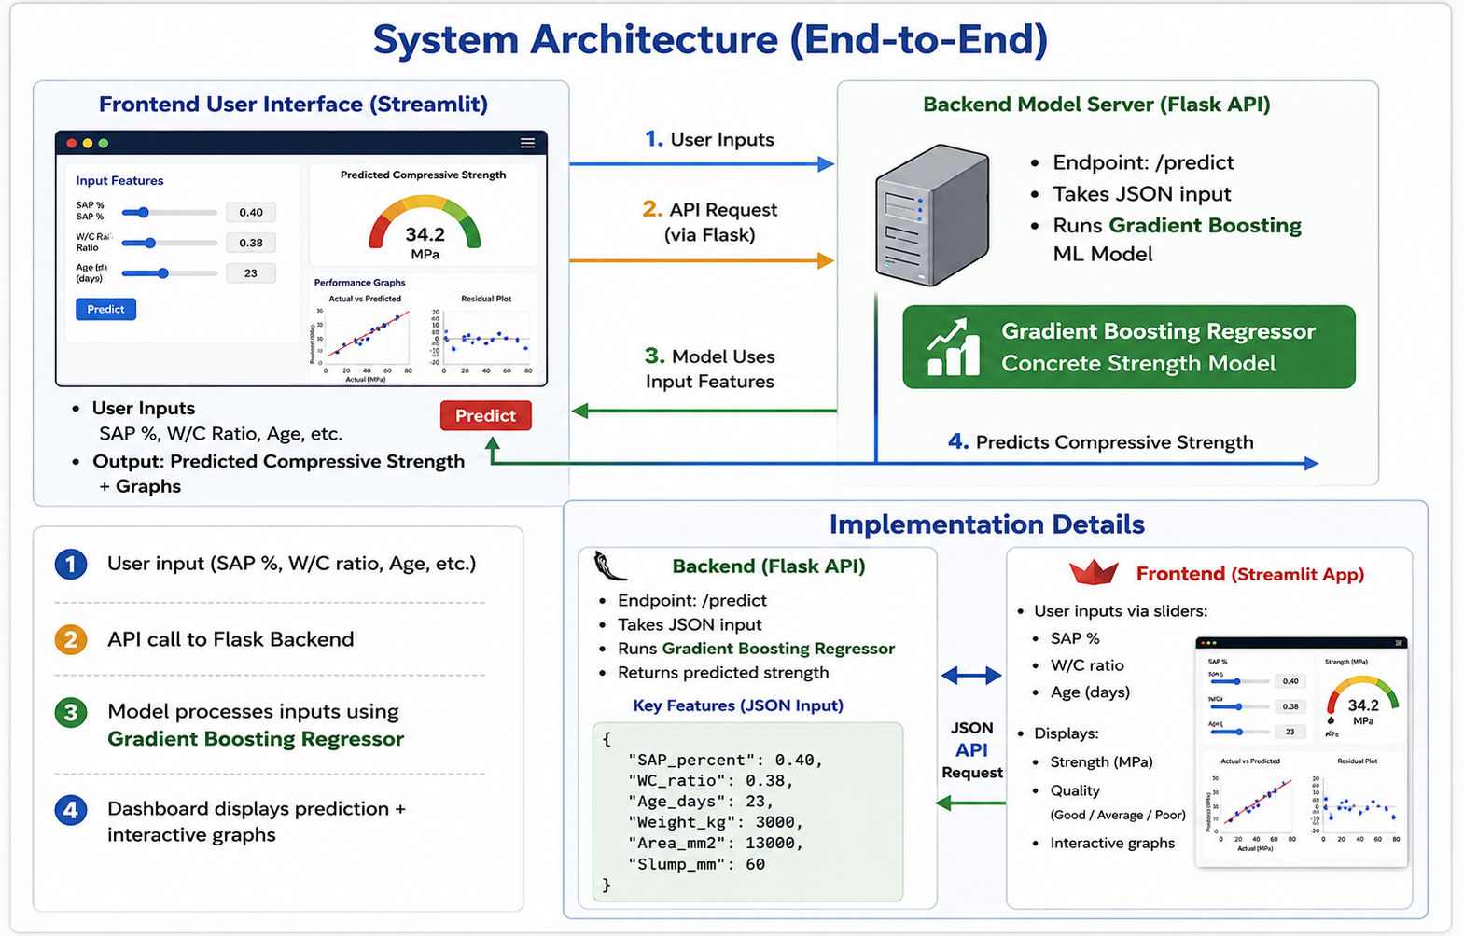

Slide 34

Deployment (Live System)
End-to-End ML system deployed using:
Frontend: Streamlit
Backend: Flask API
Features:
Real-time prediction
Interactive graphs
Strength classification
🌐 Live Application Link
Your Deployed Link Here

Slide 35
Conclusions
Pre-wetted SAP provides effective internal curing by storing and releasing water during hydration, as SAP shows effective absorption-desorption behaviour.
Workability: Slump improves with pre-wetted SAP due to additional available moisture
7-day strength: SAP mixes show slightly lower strength than the control mix.
28-day strength: SAP mixes show comparable or improved strength, especially at low w/c ratios.
Optimum SAP dosage: 0.2% - 0.4%
Recommended mix: w/c = 0.36 with 0.4% SAP (pre-wetted)
Overall: SAP improves workability and long-term strength, while excess SAP (0.6%) reduces strength due to void formation

Slide 36

Timeline

Slide 37

THANK YOU
37

